Slide 1
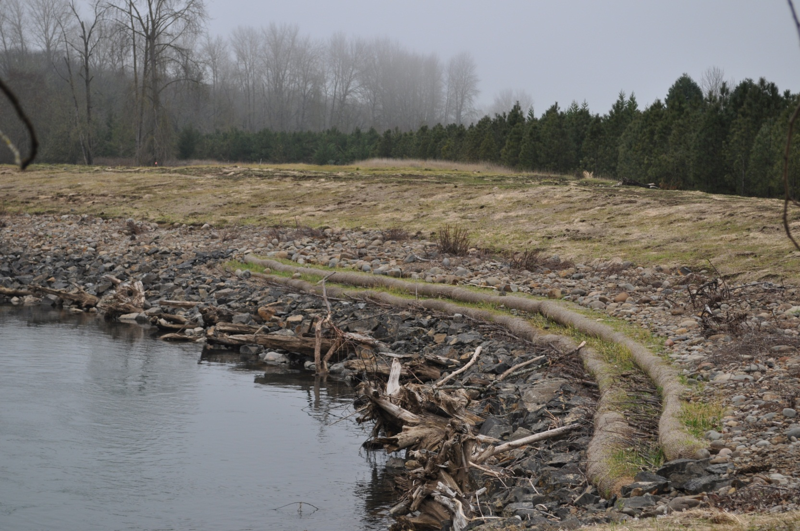
Sodom Channel Project Update
Calapooia Watershed Council
March 13, 2013
Denise Hoffert-Hay, Project Manager

Slide 2
Community Concerns from 2011-2012
Calapooia Landowner Concerns
Calapooia Channel out-of-bank for extended time period compared with pre-project conditions
Calapooia Channel flows not receding as rapidly following storm events as pre-project conditions
Sodom Channel Landowner Concerns
Sodom Channel out of bank during high flows
Sodom Channel experiencing erosion downstream from project area

Slide 3
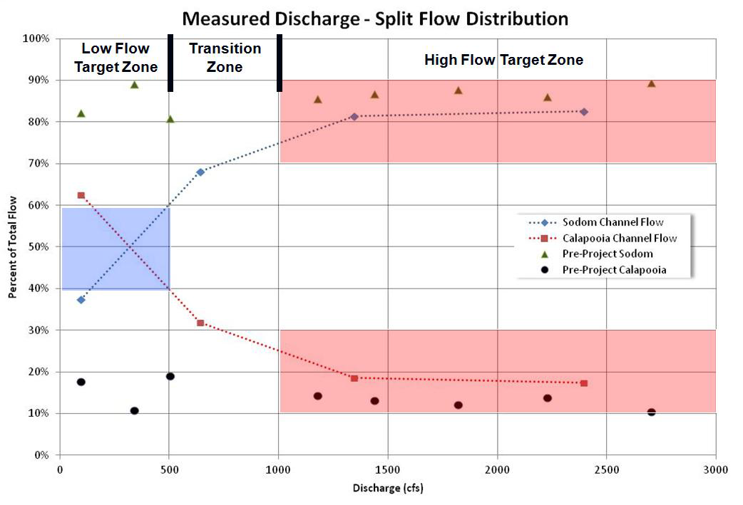
Notes:
Measured split flow conditions after project implementation (dotted lines) and historical flow conditions pre-project shown as isolated points. Target values for split flow shown with red and blue shading.

Slide 4
Adjustment 1 made to project during construction 2012
Reduced the channel cross section area of the Calapooia River at the bifurcation:
Added large wood and boulders to the Calapooia inlet.
Result:
More resistance for flow going down the Calapooia River at the bifurcation.

Slide 5
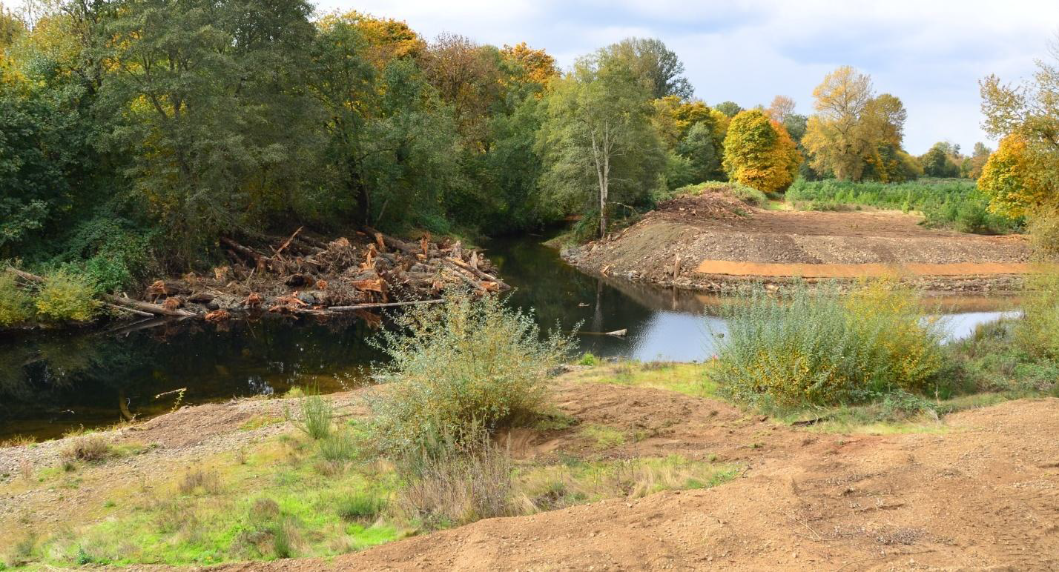
As-built view of bifurcation, 2011

Slide 6
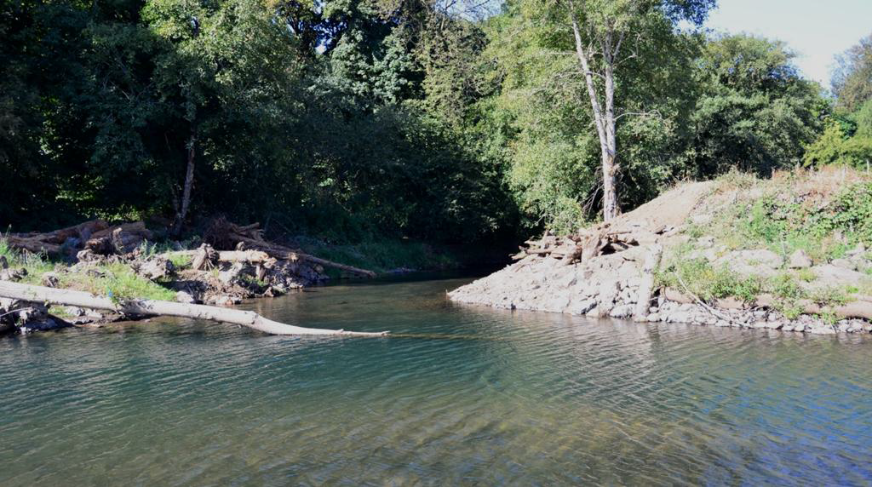
As-built view of bifurcation 2012

Slide 7
Adjustment 2 made to project during construction 2012
Existing wood piles were lowered and/or removed from the upstream riffle (Riffle 1)
Result:
Minimize the potential for large wood accumulations that can alter split flow conditions and potentially cause large rafts of wood to float down the Sodom Channel.

Slide 8
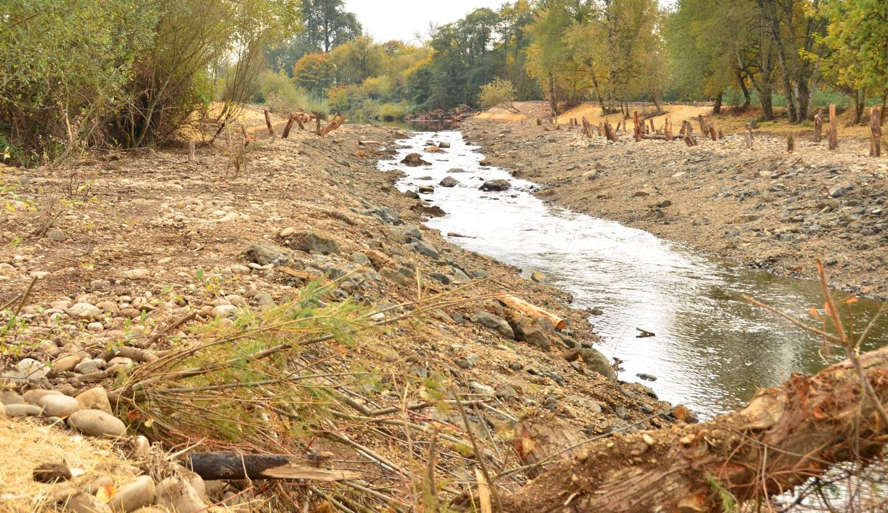
As-built view of Riffle 1 - 2011

Slide 9
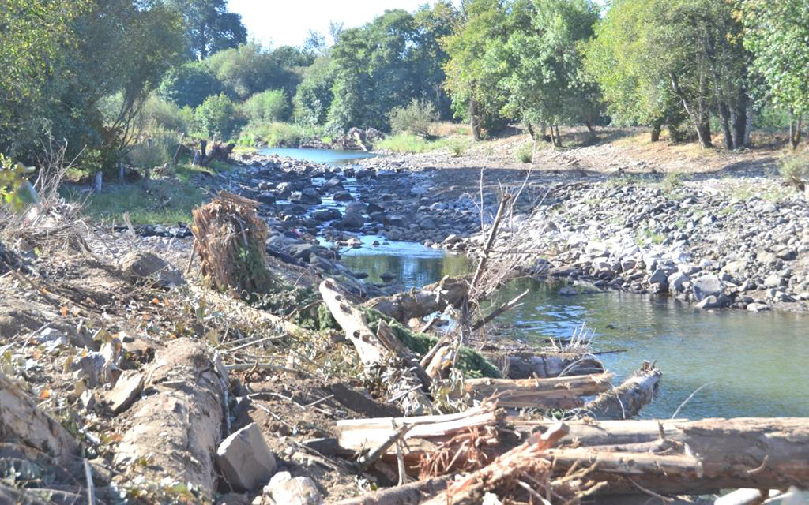
As-built view of Riffle 1 - 2012

Slide 10
Adjustment 3 made to project during construction 2012
Rock ribs in the upstream riffle on the Sodom Channel were altered to slightly enlarge the low-flow opening for the Sodom Channel.
Low flow summer channel
High flow winter channel

Slide 11
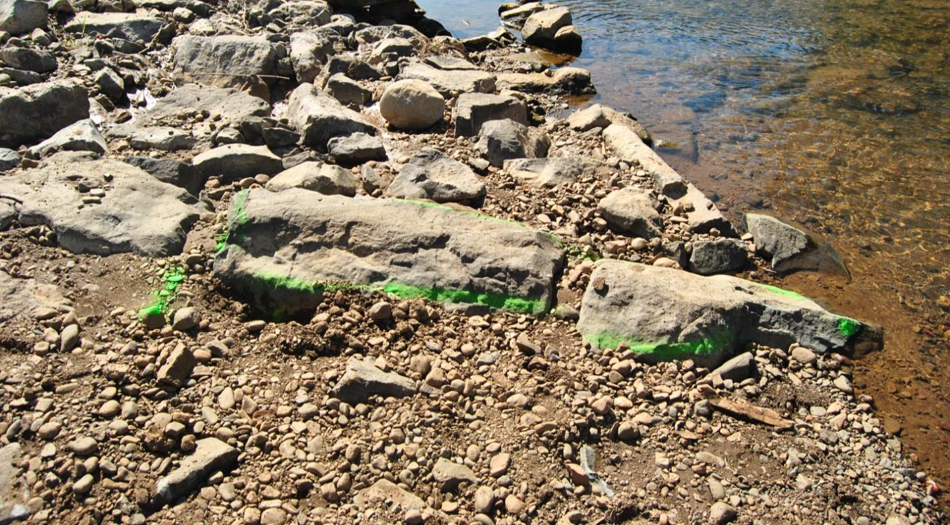
As-built view of rock rib - 2011

Slide 12
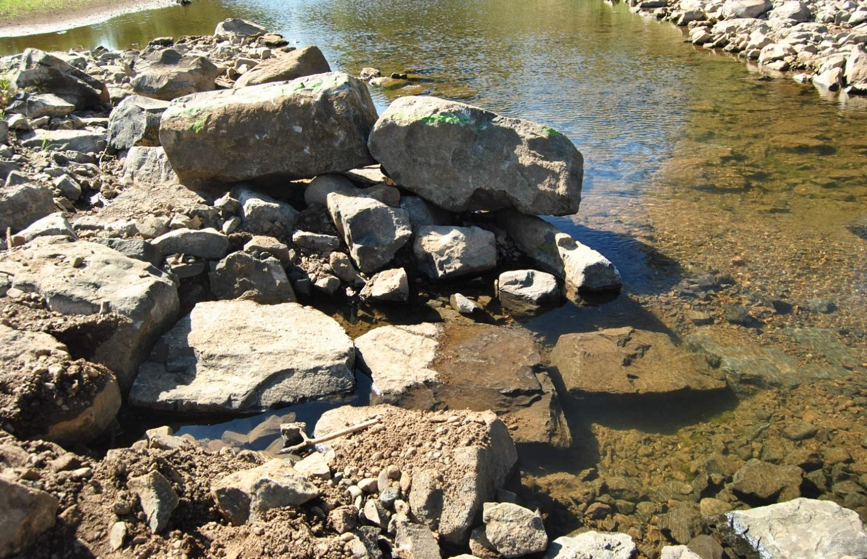
As-built view of rock-rib - 2012

Slide 13
Conclusions
Three incremental changes were made to the bifurcation area. Because the split-flow conditions were performing within the design tolerances large-scale modifications were not warranted at this time.
Additional monitoring of flows during the upcoming winter should be continued to determine if additional modifications are necessary.
Historically, the bifurcation has been very dynamic and will continue to be dynamic due to the fact that a single-thread river is being split into two rivers.

Slide 14
FEMA Funded Channel Restoration
Several winter storm events 2011-12 resulted in bank erosion between Riffles 1 and 2 that threatened to destabilize the Sodom Channel.
OR Parks and Recreation received disaster relief funding to restore the bank to prevent further migration of the channel.

Slide 15
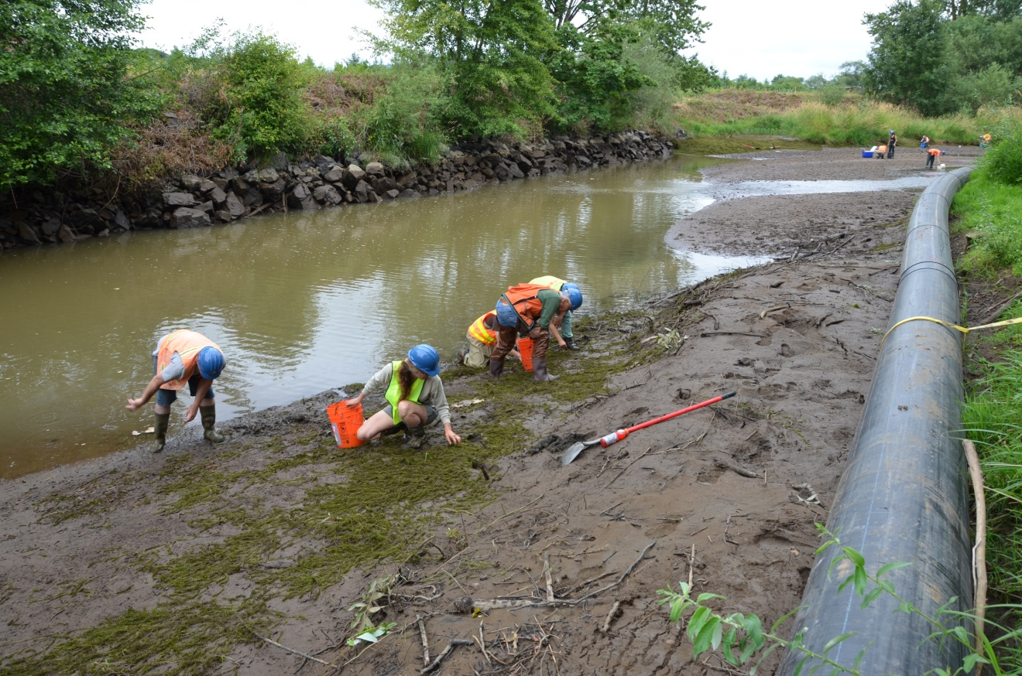
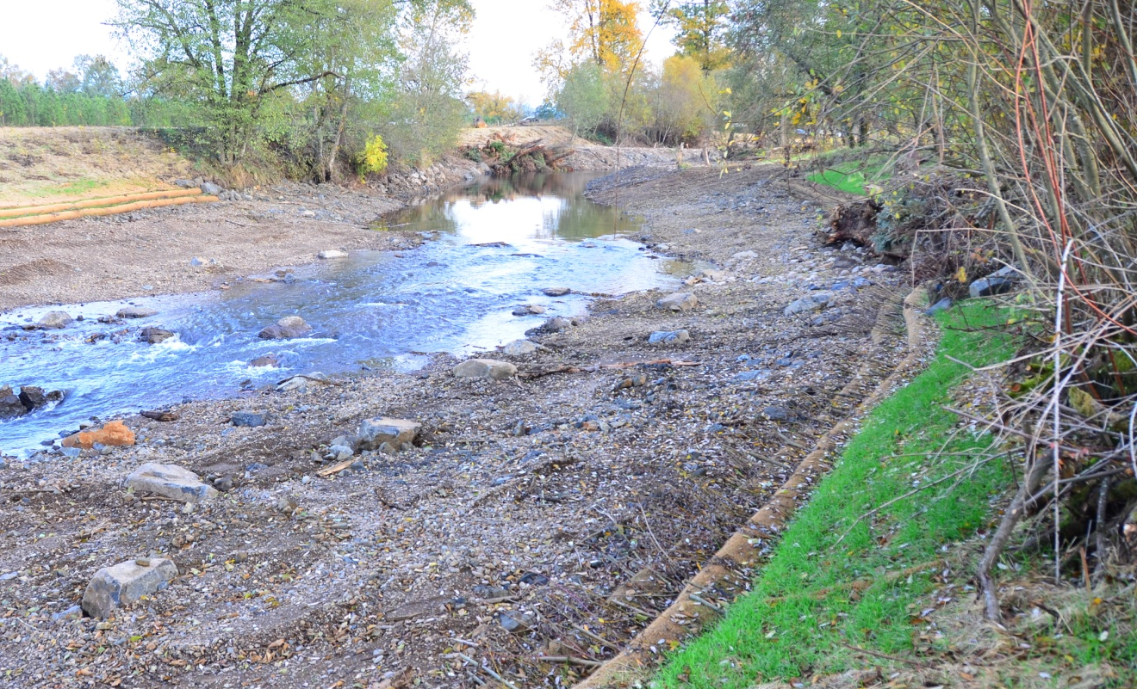
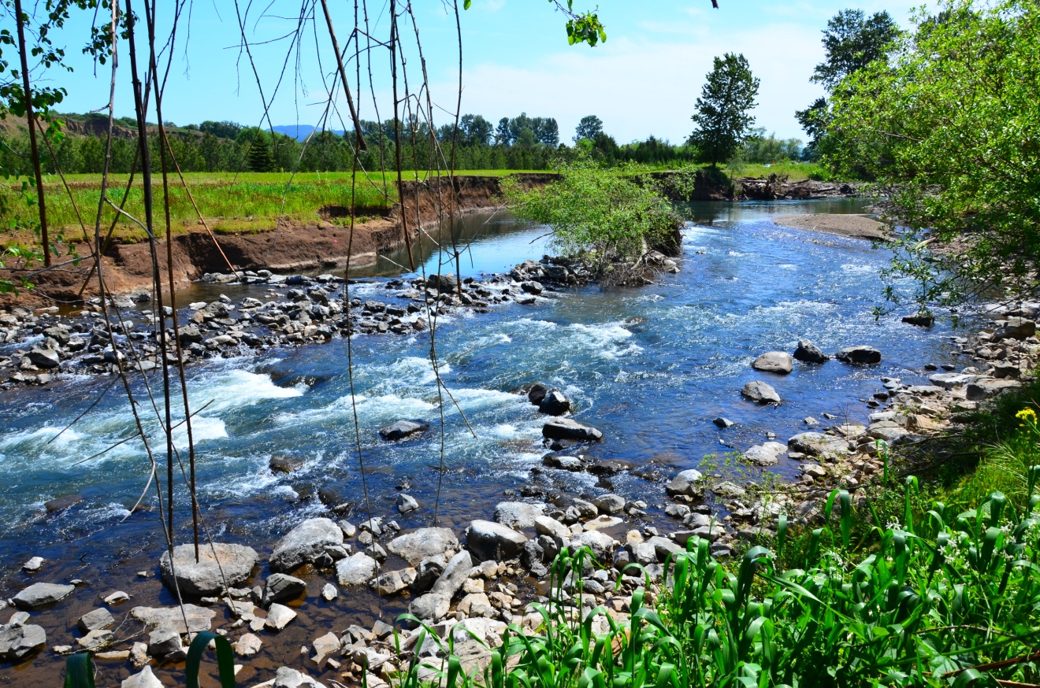

Slide 16
Restored bank – Fall 2012

Slide 17
Questions

